Slide 1






Building PowerShell GUI with SAPIEN PowerShell Studio
Maximo Trinidad
Technology Evangelist
SAPIEN Technologies, Inc.
maxt@sapien.com
@sapientech

Slide 2
Before we start
Flash drive has 45 day trials without limitation:
PrimalScript
PowerShell HelpWriter
PrimalXML
PrimalSQL
WMI Explorer
VersionRecall
PowerShell Studio
Issues with any of the trial versions, feel free to contact sales@sapien.com

Slide 3
Agenda
Console Script v. GUI Tool
Basic GUI Concepts
GUI Development Workflow
Development Exercise
What more can we do?
References
Contact info
Don’t Forget!

Slide 4
Console Script v. GUI Tool
Console Script
Generally executes linearly: Starts at line 1 and runs to the end.
Basic input options.
Basic output options.
Console handles output and error display.

Slide 5
Console Script v. GUI Tool
GUI Tool
Non-linear: driven by user interaction and the firing of Events.
Many types of controls for input.
Many types of controls for output.
No console. You are responsible for displaying output and errors.

Slide 6
Basic GUI Concept
Prior GUI build:
Create one-liner(s), function(s), or module(s)
Creating variables
Scoping is important
$script:var1 – keep local variable intact
$global:var2 – values can change any place use across the script or app.

Slide 7
Basic GUI Concepts
Demo 1
PowerShell Studio Essentials
Start Page
Option settings
Object Browser
Script, Function, and Module
Snippets
Exploring the Wizards

Slide 8
GUI Development Workflow
Use of forms and controls to encapsulate functionality, accept input and display output and errors.
Manipulate properties of objects.
Direct the user’s interaction by control placement. Typically use native reading direction.
Enable controls only when you have the correct data.

Slide 9
GUI Development Workflow
Think in events: Place your code in the proper event handler.
Objects are .NET Framework (VS-like)
Use Out-String to convert objects to single string.
Use monospace fonts to display PowerShell output.
Start using Project for GUI’s

Slide 10
GUI Development Workflow
Design
Create Project
Write, test, debug, repeat.
Create EXE with Script packager.
Deploy with MSI Builder.

Slide 11
GUI Development Workflow
Start!
DEMO 2
PowerShell Studio Essentials
Exploring Forms Wizard
Anatomy for Form and Multi-Form(s)
Forms Properties and Events
Integrating Script/Function Code
Debugging

Slide 12
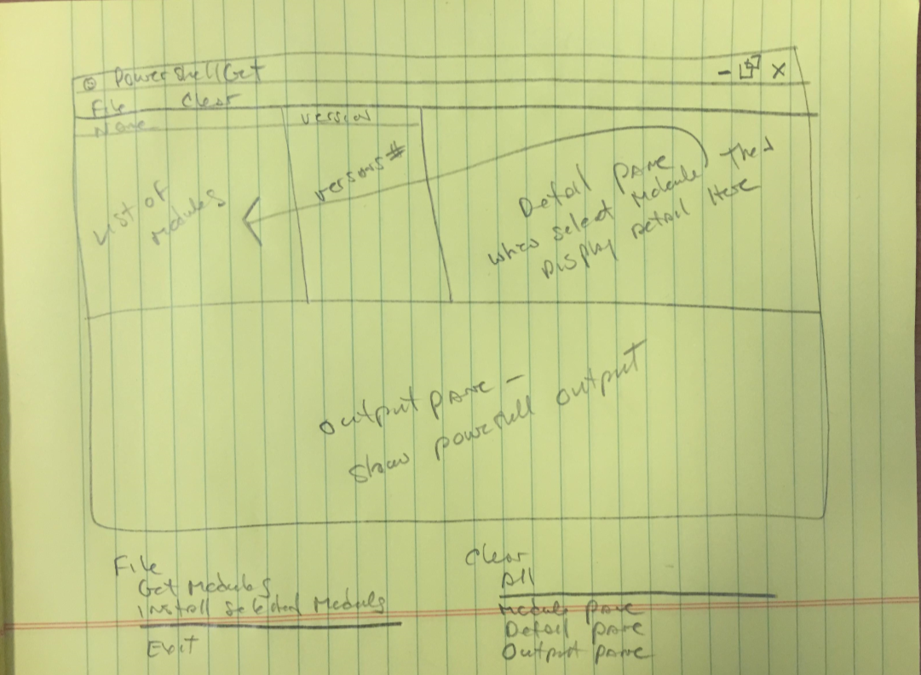
Development Exercise
Design First!

Slide 13
Development Exercise
Lay out the process flow!
Determine what modules are already installed.
Add a checked mark next to installed modules.
Add current version number next to installed modules.
Uninstall modules functionality.
Search Mechanism.

Slide 14
Development Exercise
Start preparing the code to be use in the form.
Test and Debug in console.
Source Control.
Deployment Options:
Script
Standalone Executable
MSI solution

Slide 15
Development Exercise
DEMO 3
Multi-Form sample:
“Sapien_PowerShellGet_GUI”
- Build and Execute.
- Create MSI solution.
- Deploy Application.

Slide 16
What more can we do?
Can we add more forms?
Can we add more functions?
Code improvement needed?
Is source control required?
Documentation?

Slide 17
References
SAPIEN Blog (www.sapien.com/blog)
Displaying output in a GUI application.
Managing errors in a GUI application.
Passing and returning values using forms.
Creating a GUI for CSV data.
Adding auto-complete to an input textbook.
Copy to Clipboard in a GUI application.
Books
About Face: The Essential of Interactive Design.

Slide 18
Contact Info
Web: http://www.sapien.com
Online Store: http://www.sapien.com/store
Support: http://www.sapien.com/support
Sales: sales@sapien.com
Information: info@sapien.com

Slide 19
Don’t Forget!
Fill in your survey – it’s how we do better!
Don’t lose you badge! You need it for the Social Events.
Grab the Speakers for a chat – they all have time for you!
Let everyone know what they are missing on Social Media:
#PowerShell
#PSConfAsia
Tweets (preferably with Pictures) win Prizes!!!!

